Slide 1
REACTJS
https://react.dev/learn

Slide 2
What is React.js?
React is a JavaScript library for building user interfaces.
React is used to build single-page applications.
React allows us to create reusable UI components.
Required environment: Node.js must be installed

Slide 3
Why Use React.js?
Component-based architecture.
Virtual DOM improves performance.
Reusable components save development time.
Strong community support and ecosystem.

Slide 4
Companies Using React.js
Facebook
Instagram
WhatsApp
Airbnb
Netflix

Slide 5

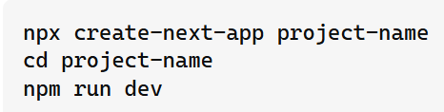
Start a New React Project
Create new react project using Next.js.
Next.js is a full-stack React framework. It’s versatile and lets you create React apps of any size—from a mostly static blog to a complex dynamic application. To create a new Next.js project, run in your terminal:
OR
https://nextjs.org/docs/app/getting-started/installation

Slide 6
Key Features of React.js
JSX (JavaScript XML)
Virtual DOM
Components and Props
State Management
Hooks
React Router

Slide 7
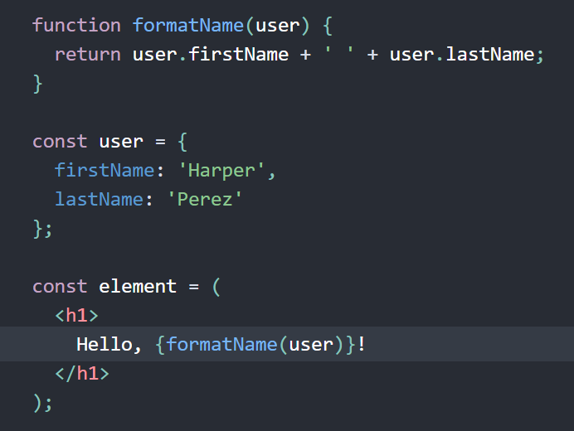
Understanding JSX
JSX is a syntax extension for JavaScript.
Allows writing HTML-like code inside JavaScript.
Instead of artificially separating technologies by putting markup and logic in separate files, React separates concerns with loosely coupled units called “components” that contain both.

Slide 8

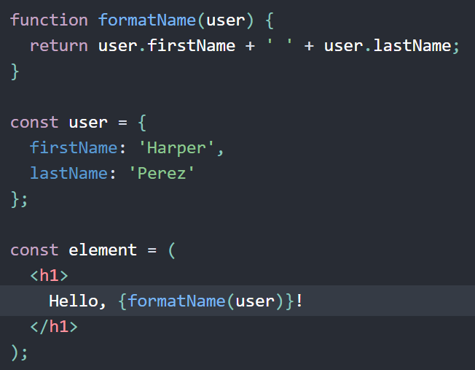
Embedding Expressions in JSX
You can put any valid JavaScript expression inside the curly braces in JSX.
For example, 2 + 2, user.firstName, or formatName(user) are all valid JavaScript expressions.
In the example below, we embed the result of calling a JavaScript function, formatName(user), into an <h1> element.

Slide 9
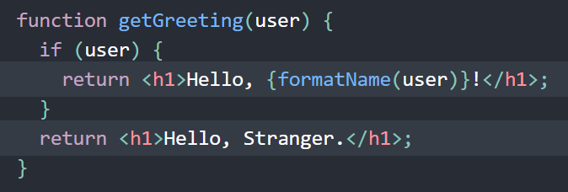
JSX is an Expression Too
After compilation, JSX expressions become regular JavaScript function calls and evaluate to JavaScript objects.
This means that you can use JSX inside of if statements and for loops, assign it to variables, accept it as arguments, and return it from functions:

Slide 10

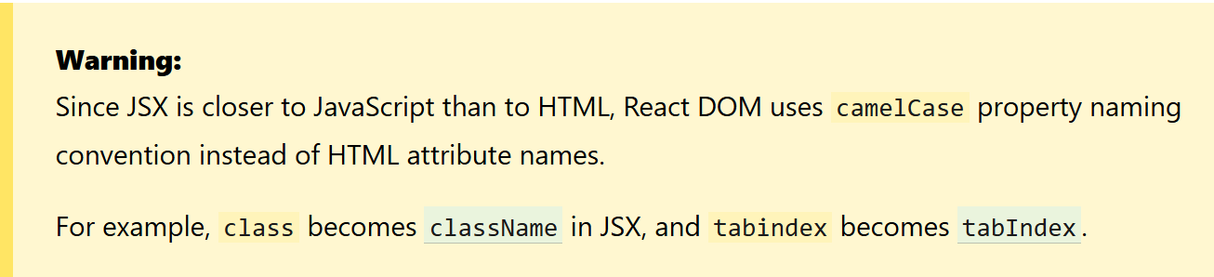
Specifying Attributes with JSX
You may use quotes to specify string literals as attributes:
You may also use curly braces to embed a JavaScript expression in an attribute:

Slide 11

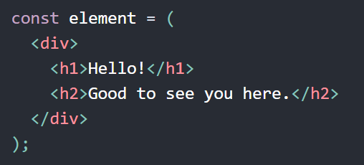
Specifying Children with JSX
If a tag is empty, you may close it immediately with />, like XML:
SX tags may contain children:

Slide 12
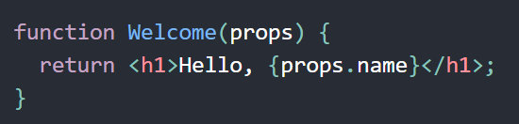
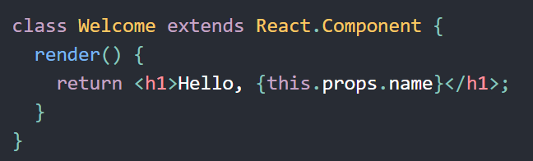
Components in React
Components are the building blocks of a React application.
Two types:
Functional Components
Class Components
The above two components are equivalent from React’s point of view.

Slide 13
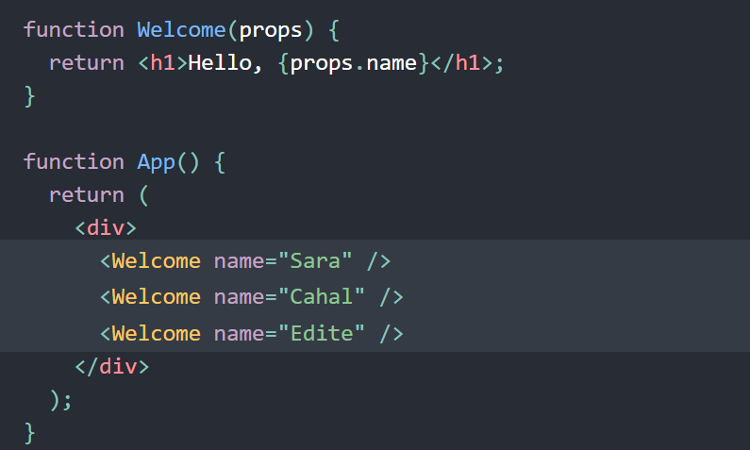
Composing Components
Components can refer to other components in their output. This lets us use the same component abstraction for any level of detail.
For example, we can create an App component that renders Welcome many times:

Slide 14
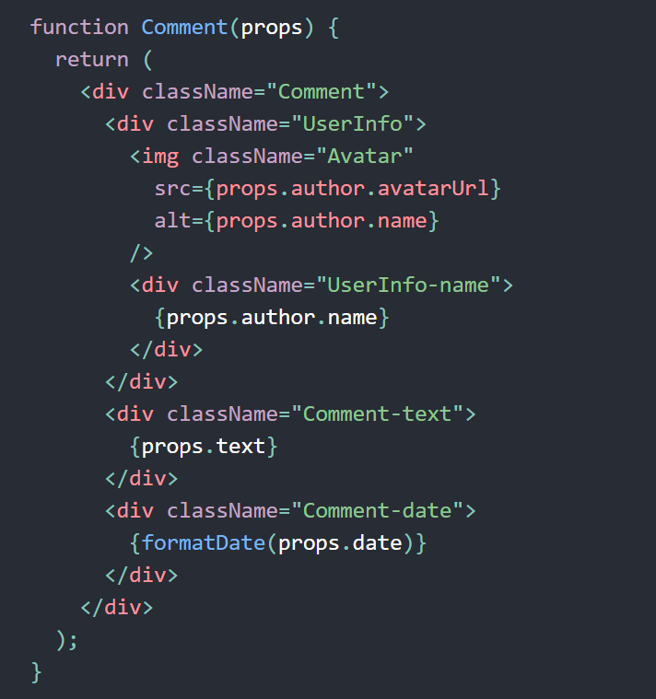
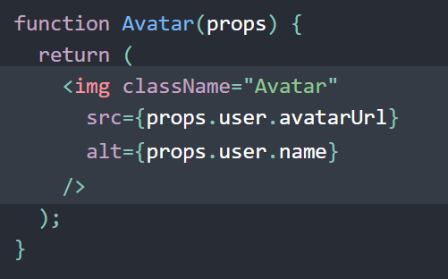
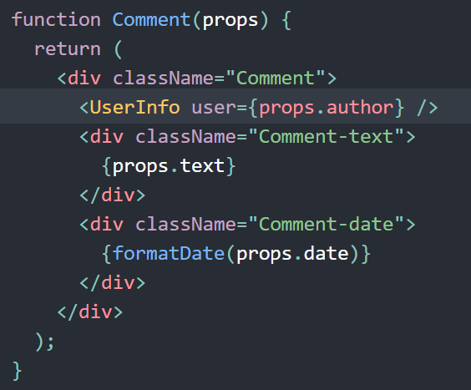
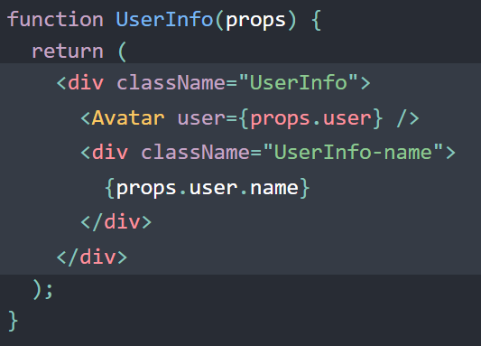
Extracting Components
Don’t be afraid to split components into smaller components.

Slide 15
Props in React
React components use props to communicate with each other.
Every parent component can pass some information to its child components by giving them props.
Props might remind you of HTML attributes, but you can pass any JavaScript value through them, including objects, arrays, and functions.

Slide 16
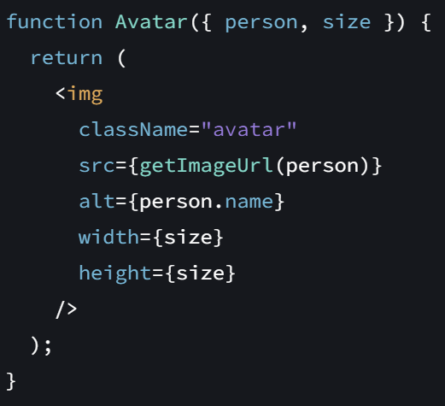
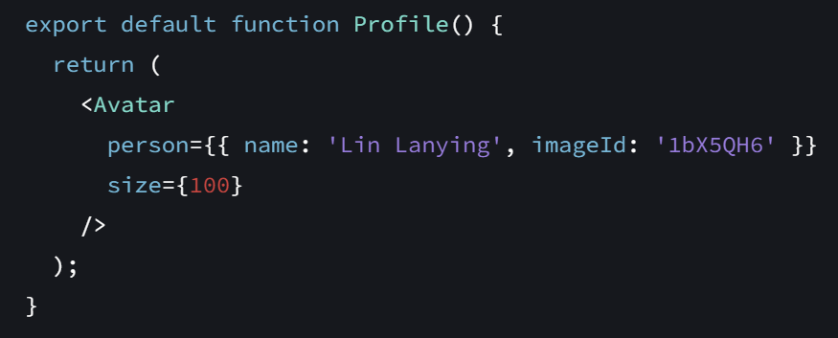
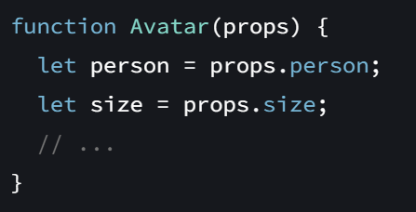
Pass props to the child component and Read props
This syntax is called “Destructuring”

Slide 17
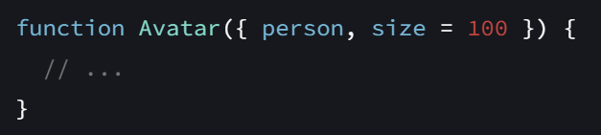
Specifying a default value for a prop
If you want to give a prop a default value to fall back on when no value is specified, you can do it with the destructuring by putting = and the default value right after the parameter
Now, if <Avatar person={...} /> is rendered with no size prop, the size will be set to 100.
The default value is only used if the size prop is missing or if you pass size={undefined}. But if you pass size={null} or size={0}, the default value will not be used.

Slide 18
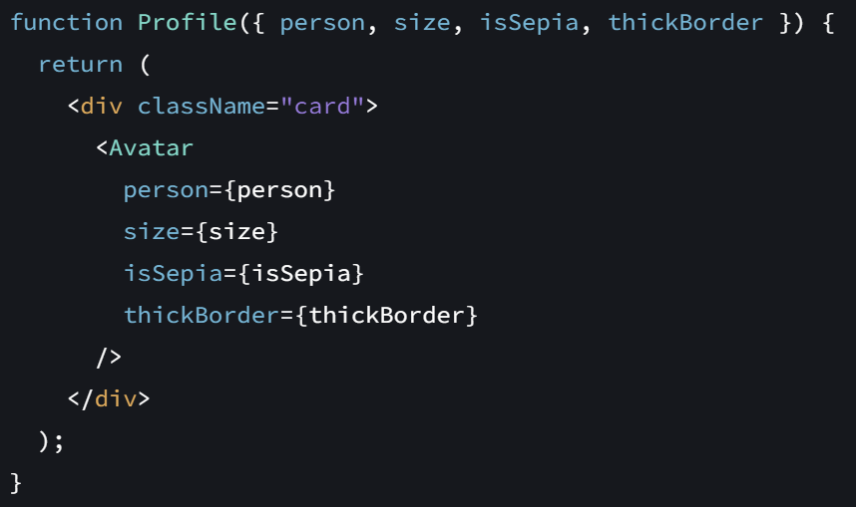
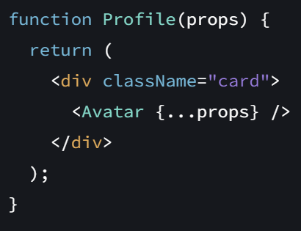
Forwarding props with the JSX spread syntax

Slide 19
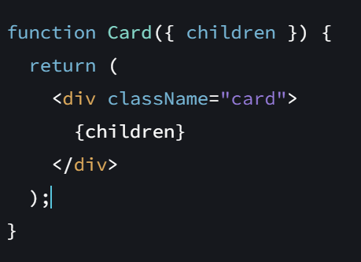
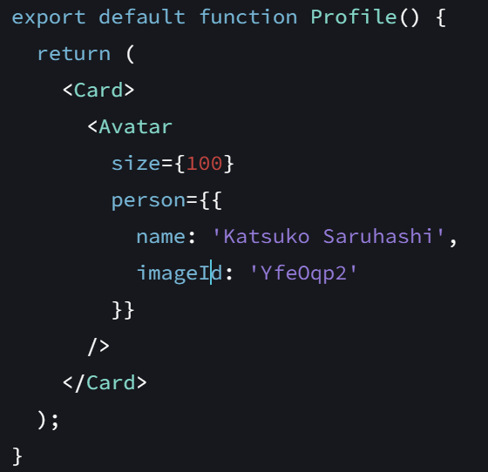
Passing JSX as children

Slide 20
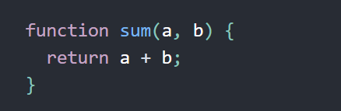
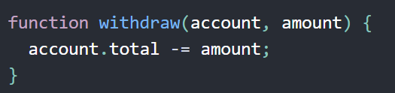
Props are Read-Only
Whether you declare a component as a function or a class, it must never modify its own props.
All React components must act like pure functions with respect to their props.
This function is called “pure” because they do not attempt to change their inputs, and always return the same result for the same inputs

Slide 21
React Lifecycle Methods (Class Components)
Your home work

Slide 22
State in React - A component’s memory
Examples:
Type in to the form => remember the current input value
Click next on the image carousel => remember current image
Click add product to cart => the shopping cart

Slide 23
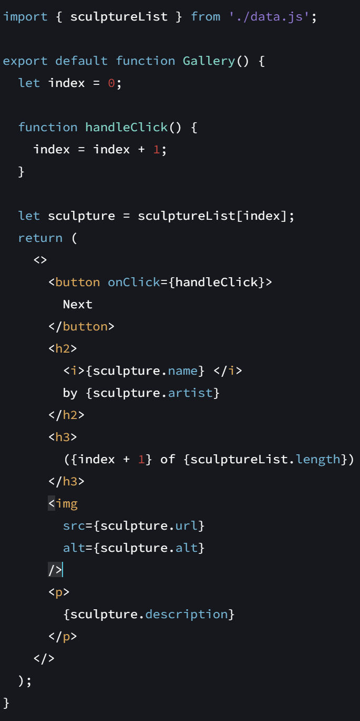

Example

Slide 24
Why nothing happen when click the Next button?
Local variables don’t persist between renders. When React renders this component a second time, it renders it from scratch—it doesn’t consider any changes to the local variables.
Changes to local variables won’t trigger renders. React doesn’t realize it needs to render the component again with the new data.

Slide 25

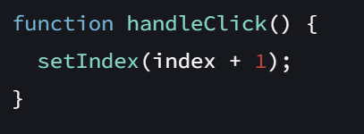

How to update component with new data?
Retain the data between renders.
Trigger React to render the component with new data (re-rendering).
The useState Hook
A state variable to retain the data between renders.
A state setter function to update the variable and trigger React to render the component again.

Slide 26
useState is a Hook
In React, useState, as well as any other function starting with “use”, is called a Hook.
Hooks are special functions that are only available while React is rendering.
State is just one of those features, but you will meet the other Hooks later.

Slide 27

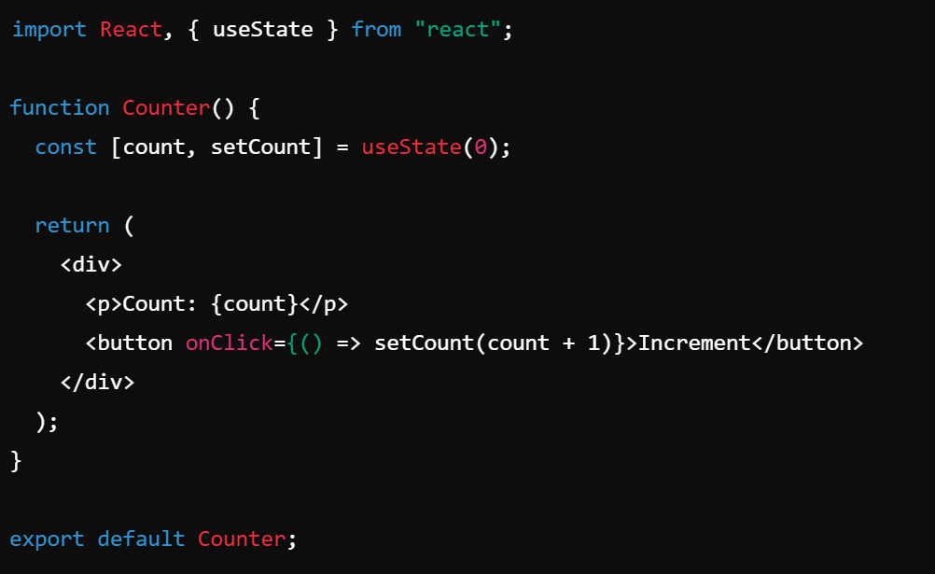
Syntax
state: The current state value.
setState: A function to update the state.
initialValue: The starting value of the state.
Example:
useState(0) initializes count with 0.
setCount(count + 1) updates the state when the button is clicked.
The component re-renders whenever the state updates.

Slide 28

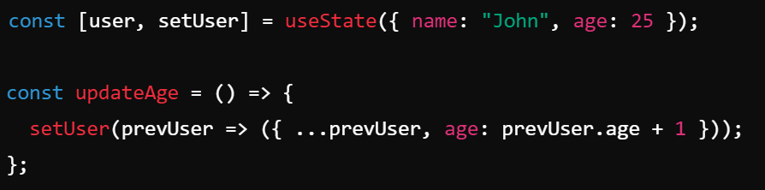
Updating State
Using a Function (Best Practice for Previous State)
If your new state depends on the previous state, use a function inside setState. This ensures you get the latest state, especially in asynchronous updates.
Updating an Object in State
Using { ...prevUser } keeps other properties intact while updating age.

Slide 29
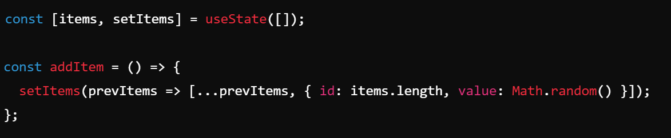
State with Arrays
Spread operator (...prevItems) ensures the array is not mutated directly.

Slide 30
Lazy Initialization
You can pass a function to useState to compute the initial state only once:
This prevents unnecessary calculations on every render.

Slide 31
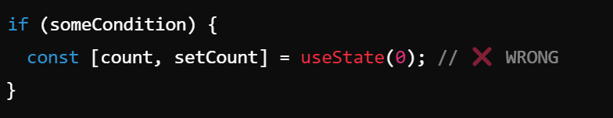
Rules of useState
Must be inside a function component – Hooks cannot be used in class components or outside component functions.
Cannot be used conditionally – Hooks should always be called in the same order.
Instead, declare hooks at the top level.

Slide 32
When to Use useState
When you need to store and update local state in a component.
When you want reactive UI updates.

Slide 33
useState - Conclusion
useState is a powerful and easy-to-use hook for managing state in React functional components.
Understanding how it works helps in building interactive and dynamic applications.

Slide 34
Hooks
Introduced in React 16.8.
Allows functional components to use state and lifecycle features.
Common hooks:
useState
useEffect
useContext
useRef
useCallback
useMemo

Slide 35
Hook - Effect hook
Effects let a component connect to and synchronize with external systems. This includes dealing with network, browser DOM, animations, widgets written using a different UI library, and other non-React code.
useEffect connects a component to an external system.
There are two rarely used variations of useEffect with differences in timing:
useLayoutEffect fires before the browser repaints the screen.
useInsertionEffect fires before React makes changes to the DOM.

Slide 36

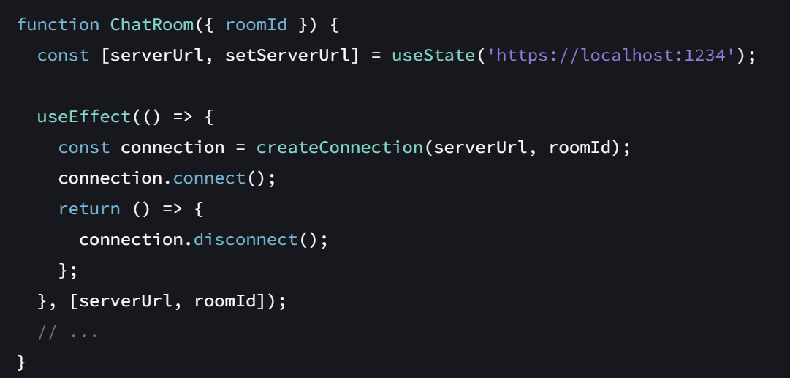
Effect Hook - useEffect
useEffect is a React Hook that lets you synchronize a component with an external system.
Call useEffect at the top level of your component to declare an Effect
setup: The function with your Effect’s logic. Your setup function may also optionally return a cleanup function.
optional dependencies: The list of all reactive values referenced inside of the setup code.
useEffect returns undefined.

Slide 37
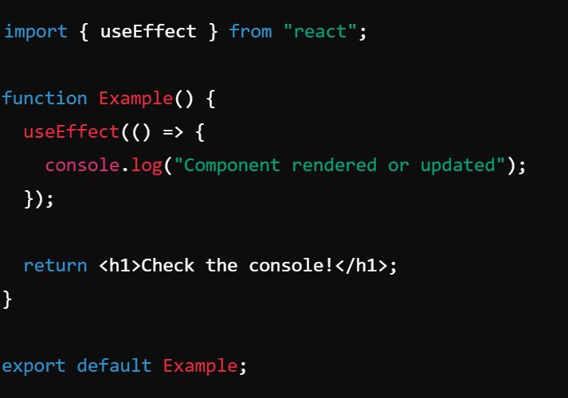
useEffect
Run on Every Render
If no dependency array is provided, useEffect runs after every render.

Slide 38
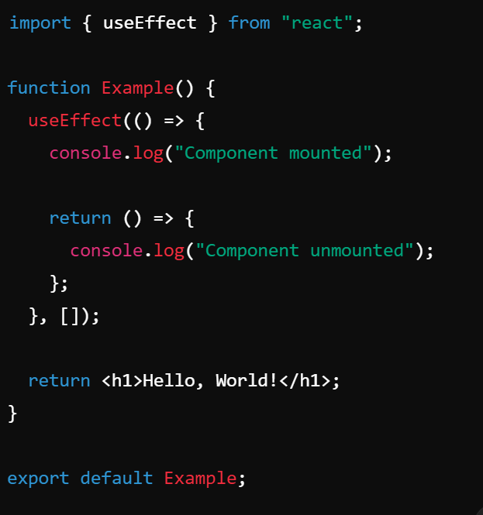
useEffect
Run Only Once (on Mount)
Adding an empty dependency array ([]) ensures the effect runs only once when the component mounts.

Slide 39
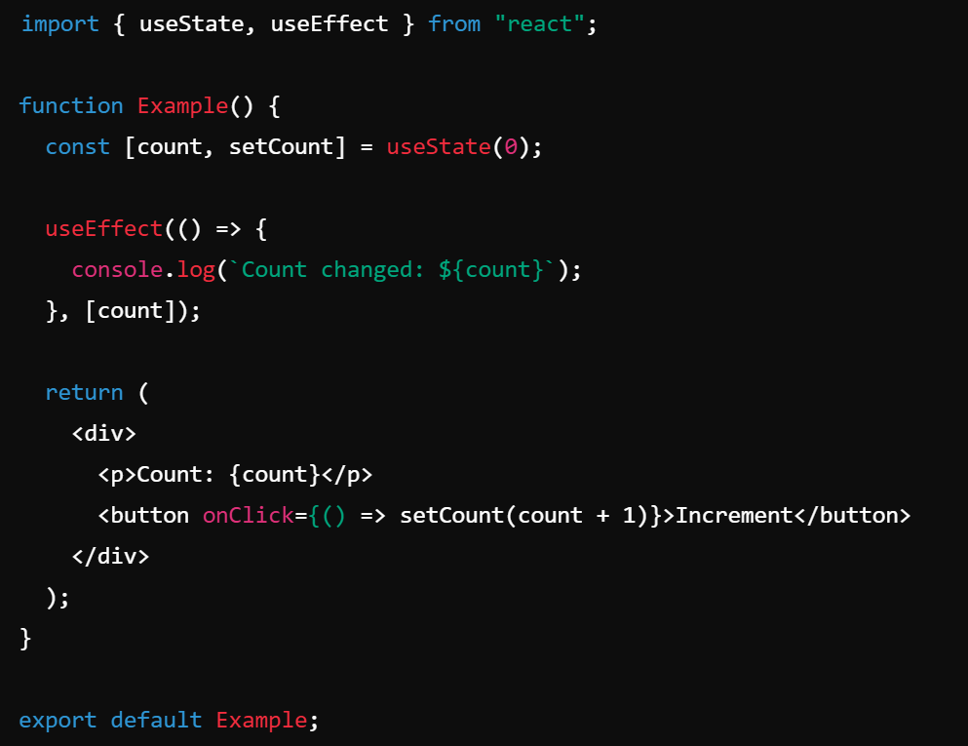
useEffect
Run When a Specific Value Changes
Provide dependencies in the array to run useEffect only when specific values change

Slide 40
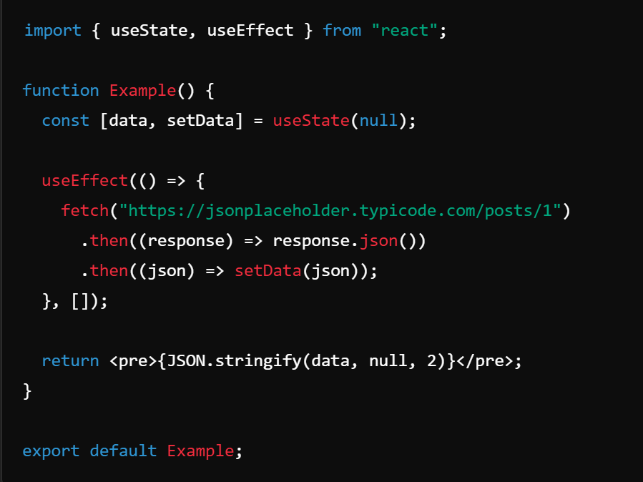
useEffect
Fetching Data Inside useEffect
Useful for making API calls when the component mounts.

Slide 41
Hook - useContext
What is useContext?
=> useContext is a React Hook that lets you read and subscribe to context from your component.
When do we use useContext?
Passing data deeply into the tree
Updating data passed via context
Specifying a fallback default value
Overriding context for a part of the tree
Optimizing re-renders when passing objects and functions

Slide 42
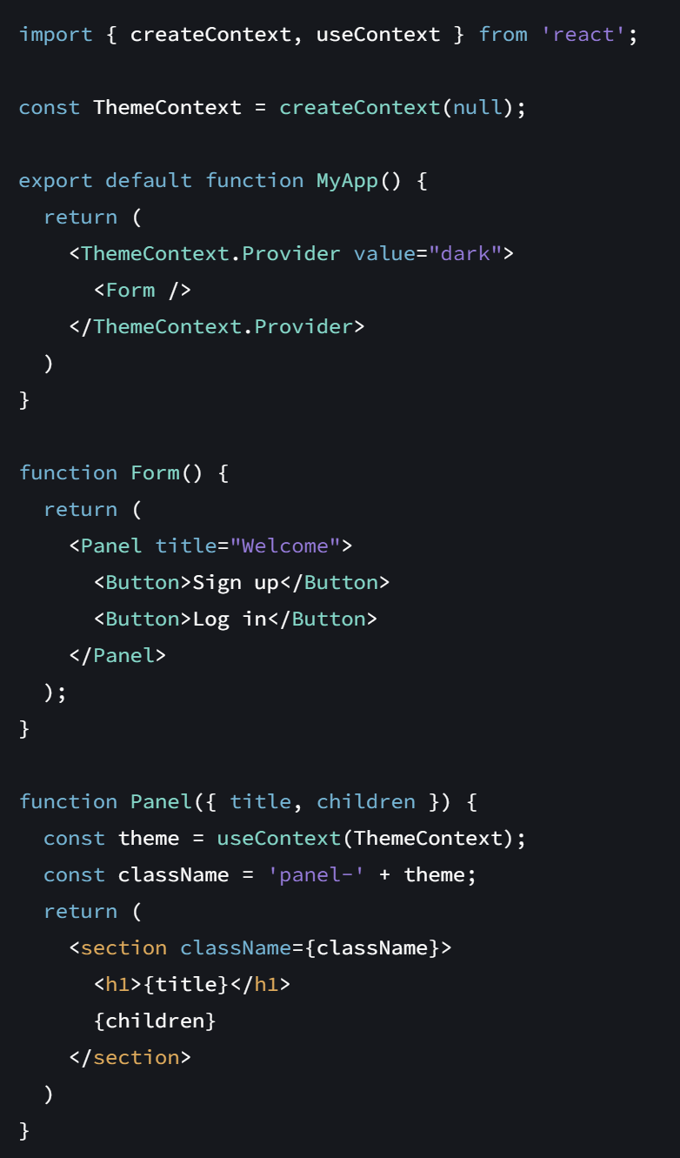
Passing data deeply into the tree
Call useContext at the top level of your component to read and subscribe to context.
useContext returns the context value for the context you passed.
To pass context to a Button, wrap it or one of its parent components into the corresponding context provider

Slide 43
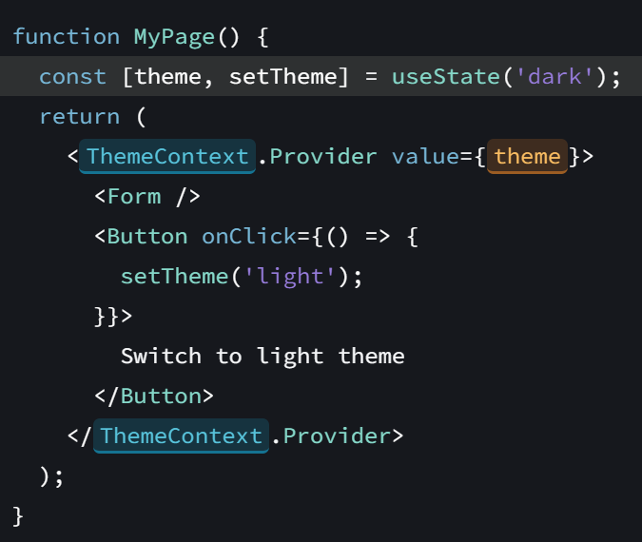
Updating data passed via context
To update context, combine it with state
Declare a state variable in the parent component, and pass the current state down as the context value to the provider.

Slide 44
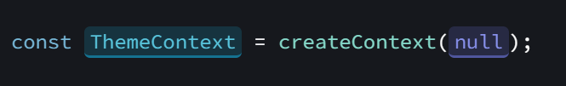

Specifying a fallback default value
If React can’t find any providers of that particular context in the parent tree, the context value returned by useContext() will be equal to the default value that you specified when you created that context
This way, if you accidentally render some component without a corresponding provider, it won’t break.

Slide 45
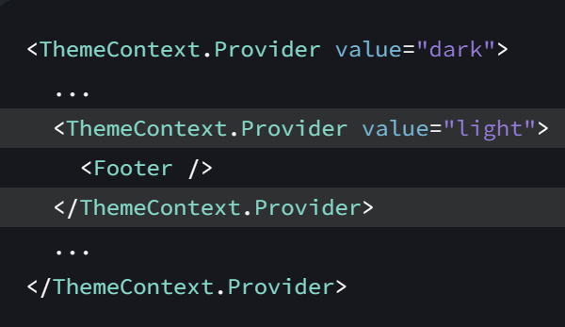
Overriding context for a part of the tree
You can override the context for a part of the tree by wrapping that part in a provider with a different value.

Slide 46
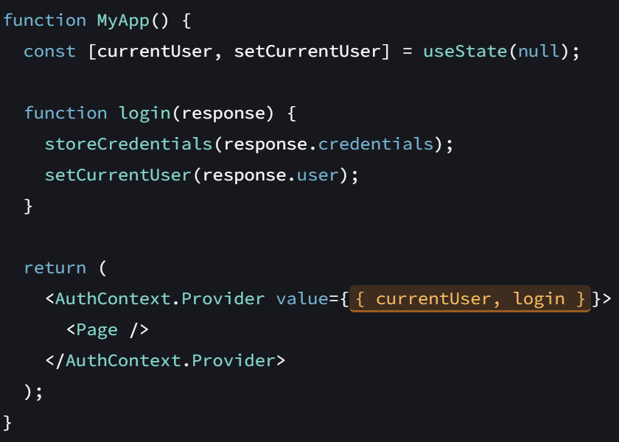
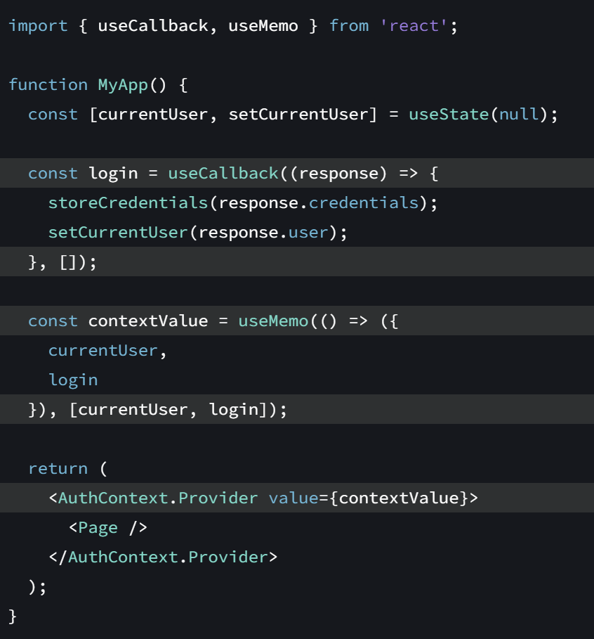
Optimizing re-renders when passing objects and functions
When MyApp need to re-render, this will be a different object pointing at a different function, so React will also have to re-render all components deep in the tree that call useContext(AuthContext)

Slide 47
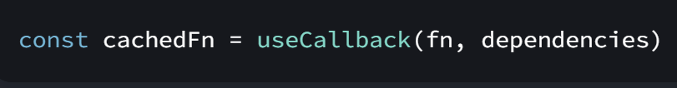
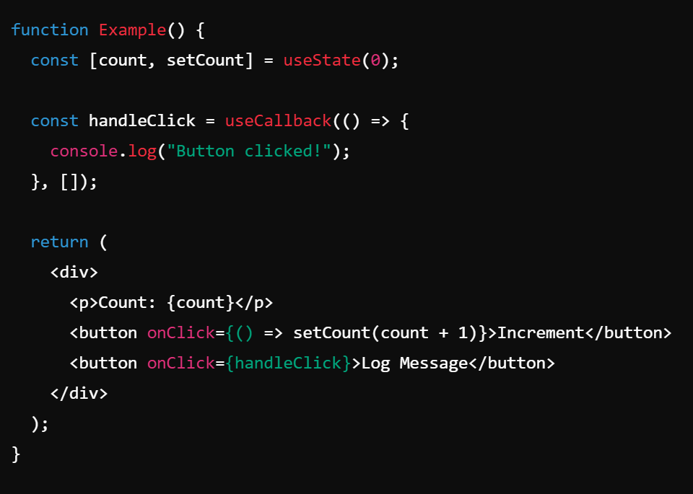
Hook - useCallback
useCallback is a React Hook that lets you cache a function definition between re-renders.
Usage
Skipping re-rendering of components
Updating state from a memoized callback
Preventing an Effect from firing too often
Optimizing a custom Hook

Slide 48
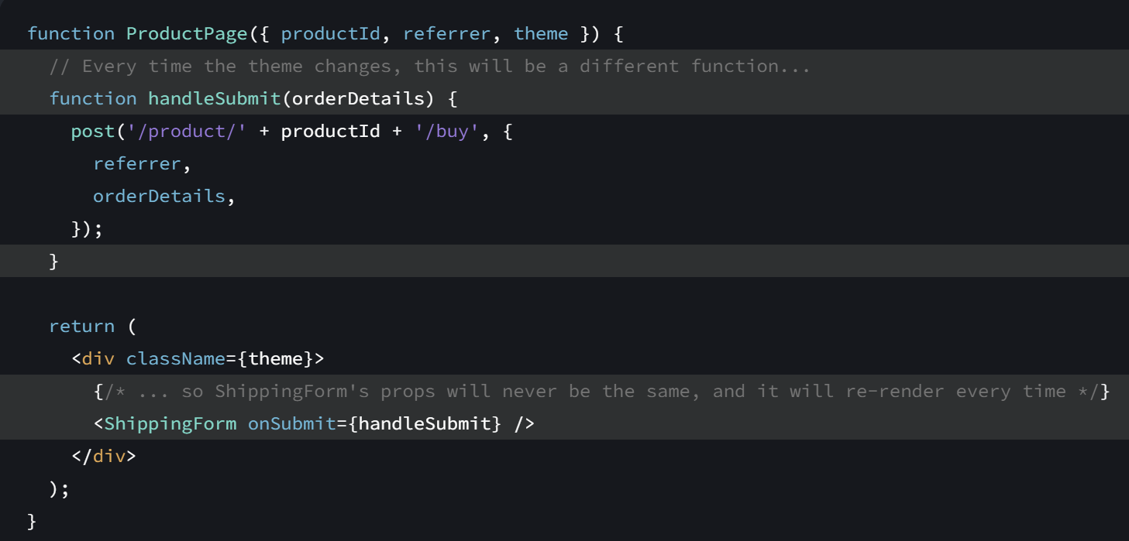
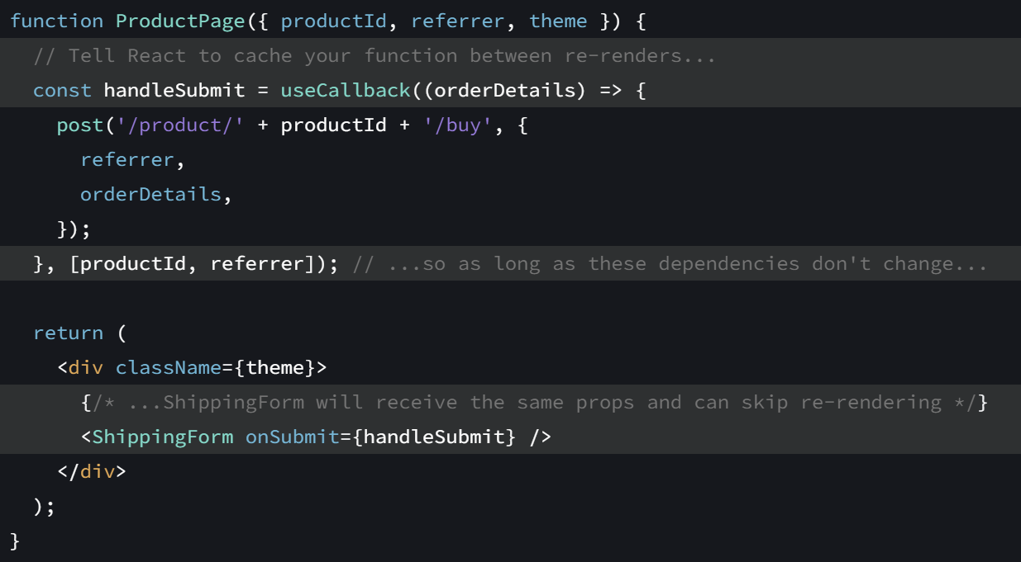
useCallback
Skipping re-rendering of components
When you optimize rendering performance, you will sometimes need to cache the functions that you pass to child components.

Slide 49
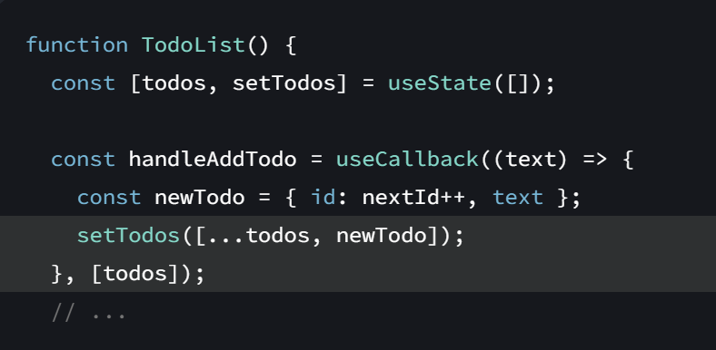
useCallback
Updating state from a memoized callback
Sometimes, you might need to update state based on previous state from a memoized callback.

Slide 50
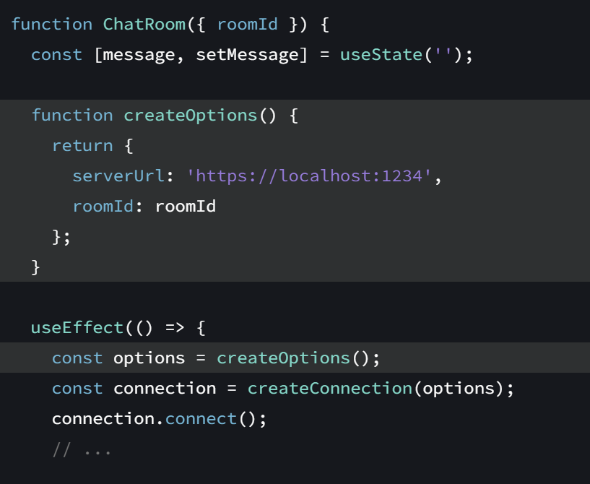
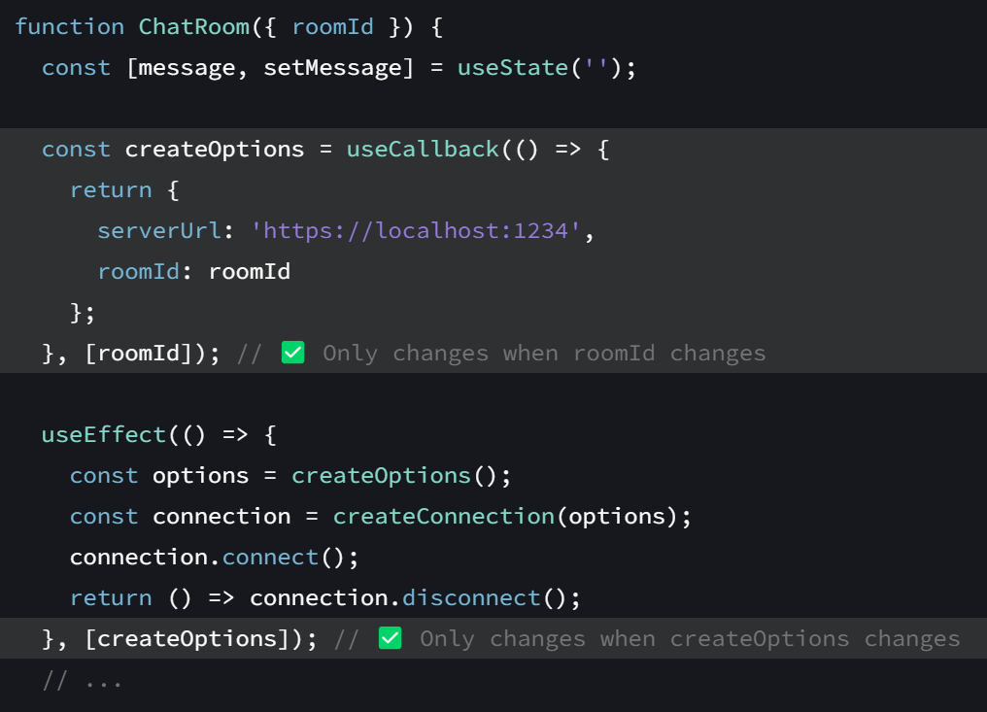
useCallback
Preventing an Effect from firing too often
Sometimes, you might want to call a function from inside an Effect:
This creates a problem. Every reactive value must be declared as a dependency of your Effect. However, if you declare createOptions as a dependency, it will cause your Effect to constantly reconnect to the chat room

Slide 51
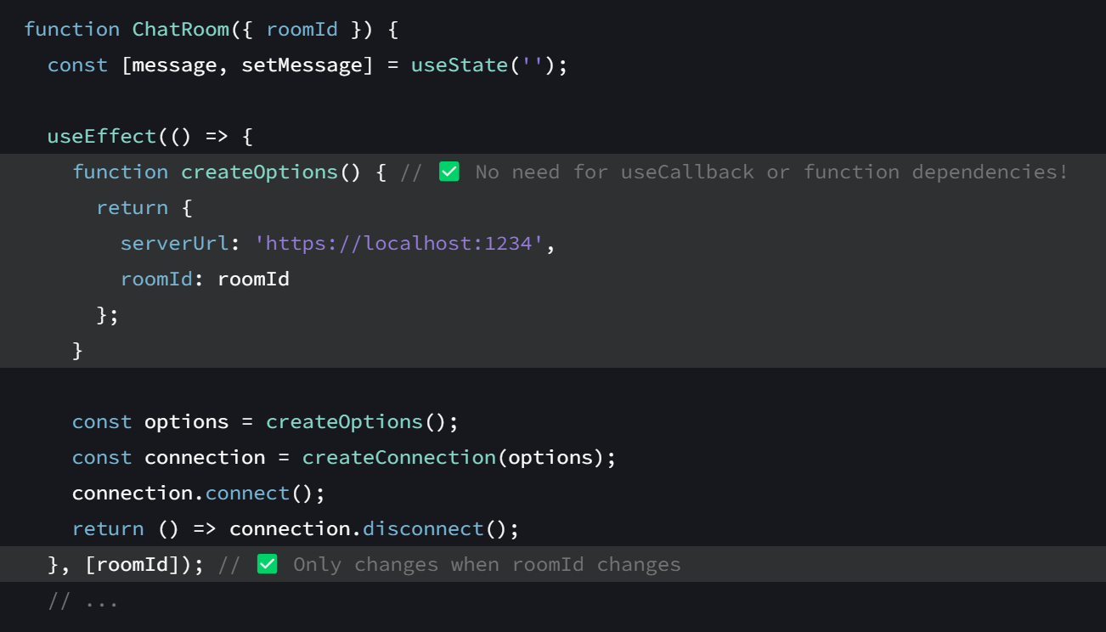
useCallback
It’s even better to remove the need for a function dependency. Move your function inside the Effect.
Now your code is simpler and doesn’t need useCallback

Slide 52
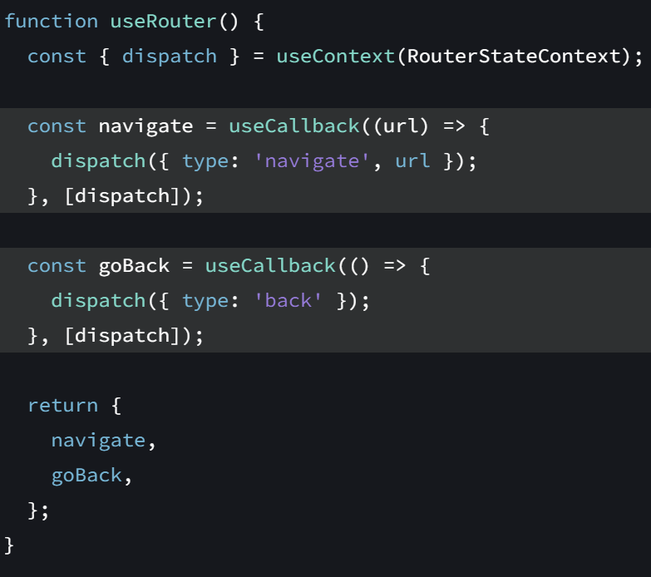
useCallback
Optimizing a custom Hook
If you’re writing a custom Hook, it’s
recommended to wrap any functions
that it returns into useCallback
This ensures that the consumers of your Hook can optimize their own code when needed.

Slide 53
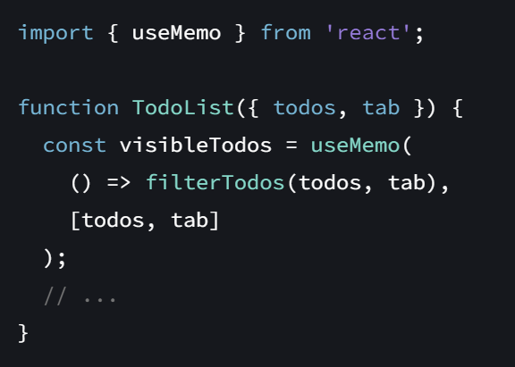

Hooks - useMemo
useMemo is a React Hook that lets you cache the result of a calculation between re-renders.
Call useMemo at the top level of your component to cache a calculation between re-renders:

Slide 54

useMemo
Skipping expensive recalculations
useMemo caches a calculation result between re-renders until its dependencies change

Slide 55

useMemo
Skipping re-rendering of components

Slide 56



useMemo
Preventing an Effect from firing too often

Slide 57


useMemo
useMemo
Memoizing a dependency of another Hook
Depending on an object like this defeats the point of memoization

Slide 58


useMemo
Memoizing a function
Suppose the Form component is wrapped in memo. You want to pass a function to it as a prop:
Wrap your functions into useCallback instead of useMemo to avoid having to write an extra nested function

